Slide 1
Chapter 5: IUS for clinical management of UC
v1.0, 10 December 2022 | EM-121011
For Healthcare Professionals only
Developed under the mentorship of the Asian Organization for Crohn's & Colitis
Supported by Janssen Asia Pacific, a division of Johnson and Johnson International (Singapore) Pte. Ltd. Editorial development by Transform Medical Communications, New Zealand
© Janssen Asia Pacific, a division of Johnson & Johnson International (Singapore) Pte. Ltd.
IUS: Intestinal ultrasound; UC: ulcerative colitis

Slide 2
About IUS Primer module
IUS Primer module was created for training gastroenterologists in Asia on adopting Intestinal Ultrasound (IUS) for the diagnosis and management of Inflammatory Bowel Disease
Transform Medical Communications was commissioned by Janssen Asia Pacific for the development of this educational module under the guidance of IUS Primer working group members and AOCC. The division of Janssen responsible for developing the module is from medical education that follows strict non-promotional and educational guidance.
The development of the module was funded by Janssen Asia Pacific, a division of Johnson and Johnson International (Singapore) Pte. Ltd. in 2022. Non-commercial use of this module is permitted without any further permission, provided credit for the content is clearly attributed to Janssen Asia Pacific.
AOCC: Asian Organization for Crohn's & Colitis; IUS: Intestinal ultrasound.

Slide 3
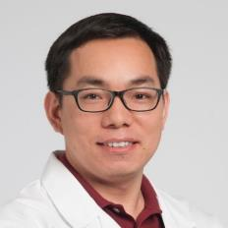
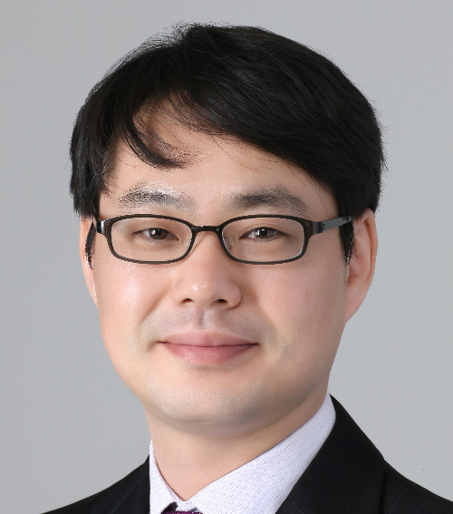
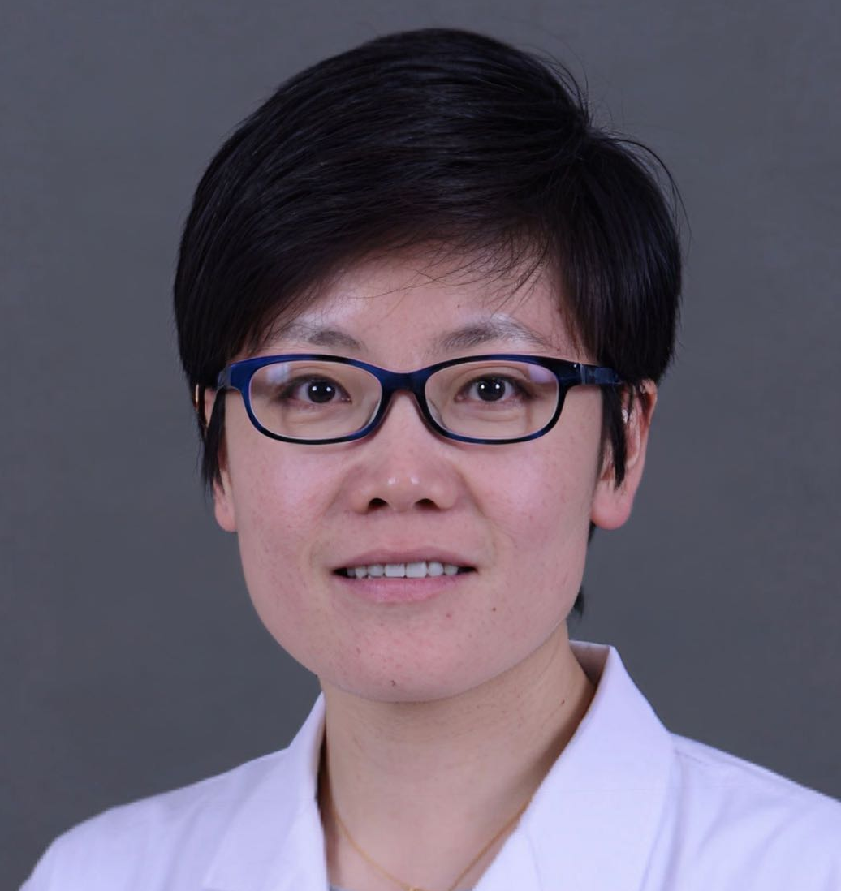
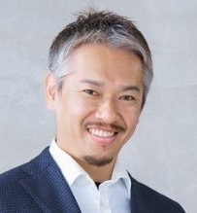
Special thanks to IUS Primer AOCC working group members
Prof. Eun Soo KIM
A/Prof. Ren MAO
Kyungpook National University
First Affiliated Hospital of Sun Yat-sen University
KOREA
CHINA
Prof. Chang Kyun LEE
A/Prof. Jun MIYOSHI
Kyung Hee University
Kyorin University
KOREA
JAPAN
Prof. Yue LI
Dr. Shintaro SAGAMI
Peking Union Medical College Hospital
Kitasato University Kitasato Institute Hospital
CHINA
JAPAN
AOCC: Asian Organization for Crohn's & Colitis; IUS: Intestinal ultrasound; WG: working group.

Slide 4
Learning Objectives
Learn the role of IUS for diagnosis and clinical management of UC
Explore the correlation of IUS findings in UC with endoscopic disease activity
Understand the IUS scoring system for UC
1
2
3
BWT: bowel wall thickness; IBD: inflammatory bowel disease; IUS: Intestinal ultrasound; UC: ulcerative colitis; WG: working group
Notes:
Key references
Bezzio C, Vernero M, Ribaldone DG, Manes G, Saibeni S. Insights into the role of gastrointestinal ultrasound in ulcerative colitis. Therap Adv Gastroenterol. 2021;14:17562848211051456. https://www.ncbi.nlm.nih.gov/pmc/articles/PMC8543554/
Frias-Gomes C, Torres J, Palmela C: Intestinal Ultrasound in Inflammatory Bowel Disease: A Valuable and Increasingly Important Tool. GE Port J Gastroenterol 2021. https://www.karger.com/Article/FullText/520212
Bots S, Nylund K, Löwenberg M, Gecse K, D'Haens G. Intestinal Ultrasound to Assess Disease Activity in Ulcerative Colitis: Development of a novel UC-Ultrasound Index. J Crohns Colitis. 2021 Aug 2;15(8):1264-1271. https://academic.oup.com/ecco-jcc/article/15/8/1264/6067606

Slide 5
Role of IUS in management of ulcerative colitis
Bowel wall thickness, stratification, colonic wall flow on doppler, and lymphadenopathy are accessible features to IUS that are correlated with UC disease levels.^{1,2}
There are no standardized or validated IUS scores for UC, the Milan Ultrasound Criteria is the most reliable and validated score.¹
The role of IUS in diagnosing and monitoring UC is less established compared to CD.¹
Clinical trials and other studies have shown that IUS is suitable for diagnosis and monitoring UC.¹
IUS: Intestinal ultrasound; UC: ulcerative colitis; CD: Crohn’s disease;
1. Jauregui-Amezaga, A., & Rimola, J. (2021). Life (Basel, Switzerland), 11(7), 603. 2. Bezzio, C. (2021). Therapeutic advances in gastroenterology, 14, 17562848211051456.
Notes:
Jauregui-Amezaga, A., & Rimola, J. (2021). Role of Intestinal Ultrasound in the Management of Patients with Inflammatory Bowel Disease. Life (Basel, Switzerland), 11(7), 603. https://doi.org/10.3390/life11070603
Bezzio, C., Vernero, M., Ribaldone, D. G., Manes, G., & Saibeni, S. (2021). Insights into the role of gastrointestinal ultrasound in ulcerative colitis. Therapeutic advances in gastroenterology, 14, 17562848211051456. https://doi.org/10.1177/17562848211051456

Slide 6
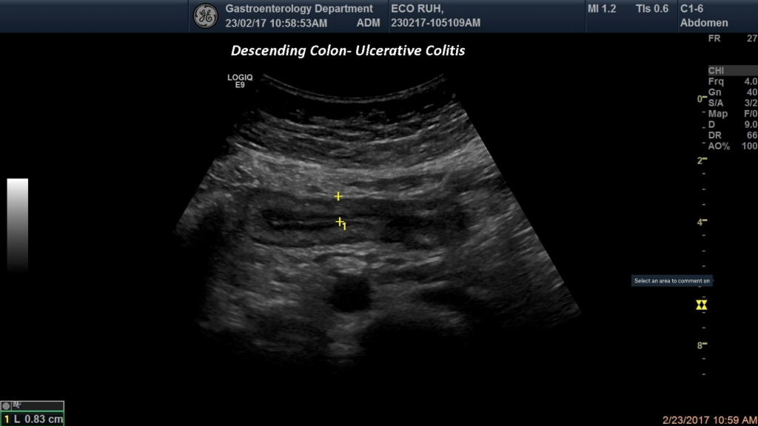
IUS imaging for a patient with UC in the descending colon
IUS was performed on a patient with bloody diarrhoea and showed bowel wall thickening of the descending colon and the loss of bowel wall stratification. Colonoscopy and biopsy confirmed ulcerative colitis of the descending colon.
Image credit: Tudor M, European Federation of Societies for Ultrasound in Medicine and Biology (EFSUMB) website. Reproduced with permission from the EFSUMB website¹, strictly for educational purposes only.
IUS: Intestinal ultrasound; UC: ulcerative colitis.
1. Tudor M, European Federation of Societies for Ultrasound in Medicine and Biology (EFSUMB). Ulcerative Colitis –Descending colon. Available at: https://efsumb.org/portfolio-item/ulcerative-colitis-descending-colon-1-image/

Slide 7
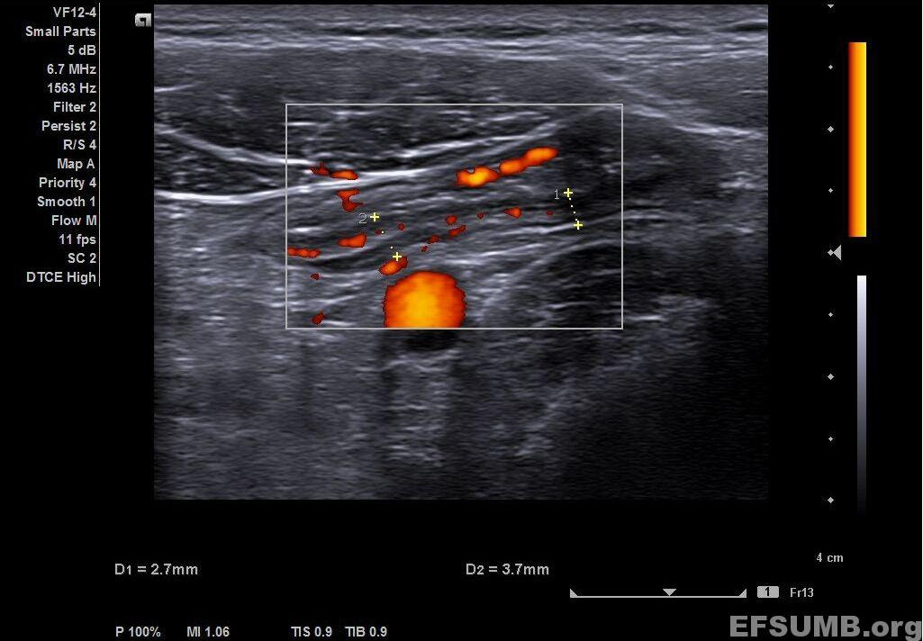
Increased Doppler signal in the thickened bowel wall in UC
IUS shows bowel wall thickness of about 3.7 mm for the sigmoid colon, with preserved stratification. In addition, there is an increased Doppler signal in the thickened bowel wall that can be interpreted as a sign of active inflammation.
Codruta, C. European Federation of Societies for Ultrasound in Medicine and Biology (EFSUMB) website. Reproduced with permission from the EFSUMB website¹, strictly for educational purposes only.
IUS: Intestinal ultrasound; UC: ulcerative colitis.
Codruta, C. European Federation of Societies for Ultrasound in Medicine and Biology (EFSUMB). Ulcerative colitis. Available at:
https://efsumb.org/portfolio-item/ulcerative-colitis/

Slide 8
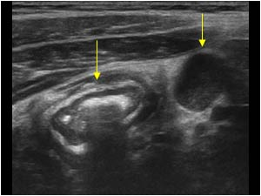
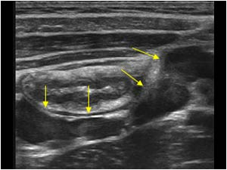
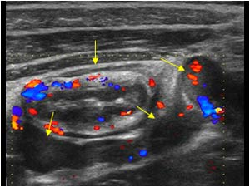
Thickened hypervascularized colon wall surrounded by enlarged mesenteric lymph nodes in UC
Thickened colon wall & enlarged lymph node
Enlarged mesenteric lymph nodes
Hypervascularized colon & enlarged lymph nodes
Lymph node
Colon
Credit for all images: UltrasoundCases.info and SonoSkills. Reproduced with permission from the Ultrasound Cases.info website¹, strictly for educational purposes only.
Thickened hypervascularized colon wall surrounded by enlarged mesenteric lymph nodes in a 13-year-old boy with UC.¹
IUS: Intestinal ultrasound; UC: ulcerative colitis.
Ultrasound Images & Clips. UltrasoundCases.info. Available at: https://www.ultrasoundcases.info/ulcerative-colitis-4146/

Slide 9
Milan Ultrasound Criteria (MUC)*
1.
Several IUS scores for UC have been proposed but, only MUC has been validated.¹
Calculation of Milan Ultrasound Criteria (MUC)
MUC³ = 1.4 × CWT + 2.0 × CWF
2.
MUC alone may be able to detect all patients with endoscopic remission and more than 70% of patients with active disease.²
>70%
3.
A MUC score >6.2 discriminated patients with active versus non-active UC with a sensitivity of 0.85 and specificity of 0.94 in an external validation study.³
Colonic wall thickening (CWT):
(average of 3 measurements) normal value ≤3 mm
Colonic wall flow (CWF): 0 = absence, 1 = presence of blood signals at colour Doppler
*Earlier name was Humanitas Ultrasound Criteria (HUC).³ Mainly used for research.
IUS: Intestinal ultrasound; UC: ulcerative colitis; CD: Crohn’s disease; CWT: colonic wall thickening; CWF: colonic wall flow; BWT: bowel wall thickness; mm: millimetres
1. Jauregui-Amezaga, A., & Rimola, J. (2021). Life (Basel, Switzerland), 11(7), 603. 2. Allocca, M. (2018). Journal of Crohn's & colitis, 12(12), 1385–1391. 3. Allocca, M. (2021). United European gastroenterology journal, 9(4), 438–442.
Notes:
Jauregui-Amezaga, A., & Rimola, J. (2021). Role of Intestinal Ultrasound in the Management of Patients with Inflammatory Bowel Disease. Life (Basel, Switzerland), 11(7), 603. https://doi.org/10.3390/life11070603
Bezzio, C., Vernero, M., Ribaldone, D. G., Manes, G., & Saibeni, S. (2021). Insights into the role of gastrointestinal ultrasound in ulcerative colitis. Therapeutic advances in gastroenterology, 14, 17562848211051456. https://doi.org/10.1177/17562848211051456

Slide 10
Correlation of MUC with endoscopic activity
MUC* > 6.2^{1,2}
Non-Active disease
Active disease
Mayo endoscopic sub-score¹
0
1
2
3
Normal or inactive disease
Erythema, decreased vascular pattern, mild friability
Absent vascular pattern, erosions
Spontaneous bleeding, ulceration
*Mainly used for research.
BWT: bowel wall thickness. MUC: Milan Ultrasound Criteria
1. Allocca, M. (2018). Journal of Crohn's & colitis, 12(12), 1385–1391. 2. Allocca, M. (2021). United European gastroenterology journal, 9(4), 438–442.
Notes:
1. Allocca, M., Fiorino, G., Bonovas, S., Furfaro, F., Gilardi, D., Argollo, M., Magnoni, P., Peyrin-Biroulet, L., & Danese, S. (2018). Accuracy of Humanitas Ultrasound Criteria in Assessing Disease Activity and Severity in Ulcerative Colitis: A Prospective Study. Journal of Crohn's & colitis, 12(12), 1385–1391. https://doi.org/10.1093/ecco-jcc/jjy107
2. Allocca, M., Filippi, E., Costantino, A., Bonovas, S., Fiorino, G., Furfaro, F., Peyrin-Biroulet, L., Fraquelli, M., Caprioli, F., & Danese, S. (2021). Milan ultrasound criteria are accurate in assessing disease activity in ulcerative colitis: external validation. United European gastroenterology journal, 9(4), 438–442. https://doi.org/10.1177/2050640620980203

Slide 11
Reliability of IUS vs endoscopy for monitoring treatment response in UC
Study details
A prospectively study evaluated IUS for treatment response in UC in a longitudinal cohort by using endoscopy and histology as gold standards. Thirty patients were included, with 27 patients completing follow-up. The primary outcome was difference in BWT for endoscopic improvement vs no endoscopic improvement. Endoscopic remission was defined as EMS = 0, improvement as EMS ≤1, and response as a decrease of EMS ≥1.
Most accurate cutoff values for BWT corelating with remission/improvement/response on endoscopy
Clinical response on endoscopy | BWT
Endoscopic remission (EMS=0) | 2.8 mm
Improvement on endoscopy (EMS≤1) | 3.9 mm
Response on endoscopy (EMS≥1) | 32% decrease
Consecutive patients with moderate to severe UC (EMS ≥2) starting tofacitinib treatment were included.
Patients were evaluated at baseline and after 8 weeks of tofacitinib induction by means of clinical, biochemical, endoscopic (EMS and UC endoscopic index for severity), histologic (Robarts Histopathologic Index) and IUS assessments.
Key results using IUS monitoring²
BWT correlated with EMS (ρ = 0.68, P < .0001), UC endoscopic index for severity (ρ = 0.73, P < .0001) and Robarts Histopathologic Index (ρ = 0.49, P = .002).
IUS: Intestinal ultrasound; UC: ulcerative colitis; BTW: bowel wall thickness; EMS: endoscopic Mayo score.
de Voogd, F. (2022). Gastroenterology, S0016-5085(22)00966-0. Advance online publication.
Notes:
de Voogd, F. (2022). Gastroenterology, S0016-5085(22)00966-0. Advance online publication.

Slide 12
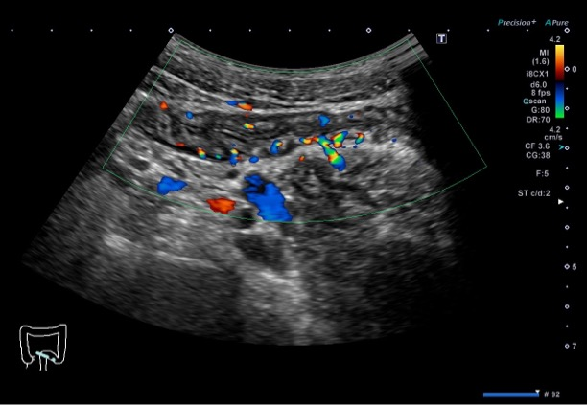
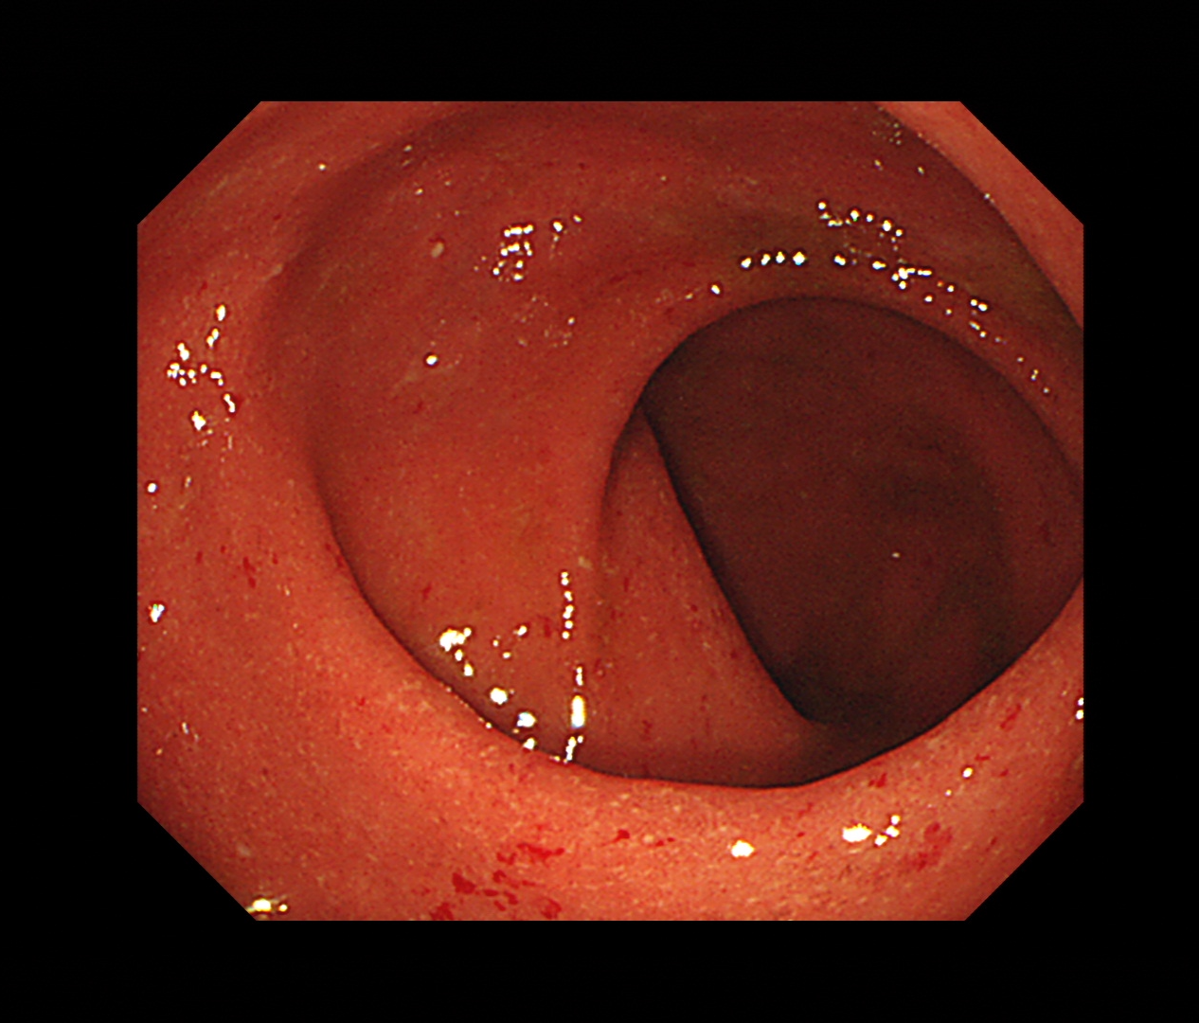
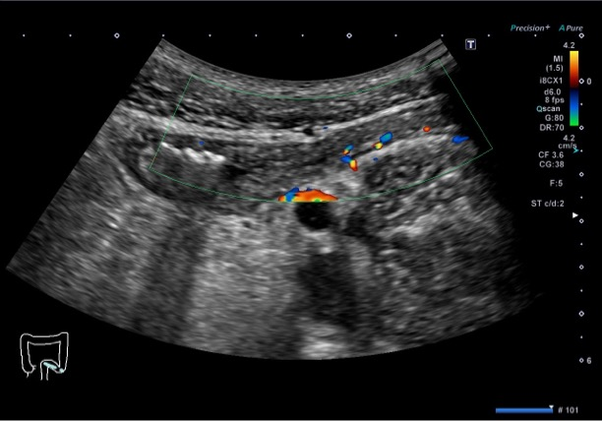
Comparing IUS and endoscopic findings for monitoring treatment response in UC
Patient case A: At baseline
Patient case A: Week 1
Week 1: No response to prednisolone
Patient case A: Week 1
Photo kindly provided by A/Prof. Jun Miyoshi, Kyorin University School of Medicine, Japan
Photo kindly provided by A/Prof. Jun Miyoshi, Kyorin University School of Medicine, Japan
Photo kindly provided by A/Prof. Jun Miyoshi, Kyorin University School of Medicine, Japan
IUS: Intestinal ultrasound; UC: ulcerative colitis; BTW: bowel wall thickness; TNF: Tumor necrosis factor.

Slide 13
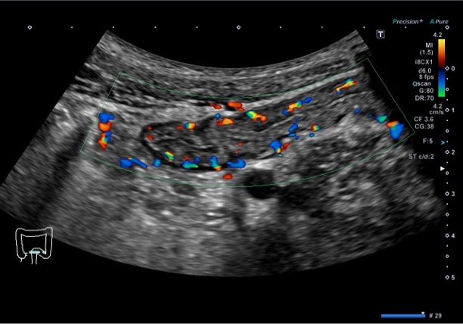
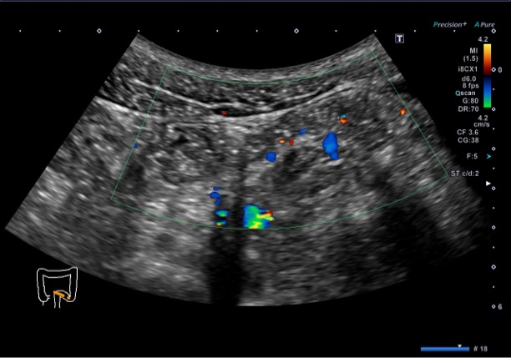
IUS for monitoring treatment response in UC (contd.)
Week 1 post anti-TNF: Clinical response on doppler IUS
Month 3 post anti-TNF: Normal on doppler IUS
Patient case A: Week 1 post anti-TNF
Patient case A: Month 3 post anti-TNF
Photo kindly provided by Prof. Jun Miyoshi, Kyorin University School of Medicine, Japan
Photo kindly provided by A/Prof. Jun Miyoshi, Kyorin University School of Medicine, Japan
Photo kindly provided by A/Prof. Jun Miyoshi, Kyorin University School of Medicine, Japan
IUS: Intestinal ultrasound; UC: ulcerative colitis; BTW: bowel wall thickness; TNF: Tumor necrosis factor.

Slide 14
Insights from TRUST&UC study on role of IUS in management of UC
Intestinal ultrasound for monitoring therapeutic response in ulcerative colitis
TRUST&UC study strongly shows IUS as a non-invasive, patient-centric and objective tool for follow-up of patients with UC to monitor treatment success.¹
Click to Play
Summary video on the TRUST&UC study group, presented by the lead investigator, Prof. Dr. med. Christian Maaser (duration: 3.18 min)
Maaser C [Gut], Oct 7, 2020. Intestinal ultrasound for monitoring therapeutic response in ulcerative colitis. YouTube. https://www.youtube.com/watch?v=yJmT9Omp_LM&ab_channel=Gut
TRUST&UC: Transabdominal Ultrasonography of the bowel in subjects with IBD To monitor disease activity with UC; IUS: Intestinal ultrasound; UC: ulcerative colitis
1. Maaser, C. (2020). Gut. 69(9), 1629–1636.
Notes:
Maaser C, Petersen F, Helwig U On behalf of the German IBD Study Group and the TRUST&UC study group, et al. Gut 2020;69:1629-1636.

